Slide 1
WEATHER PREDICT
Before you step out, check the Weather...
DATA MINING AND MACHINE LEARNING 2021/2022
Aida Himmiche
Michael Asante

Slide 2
SUMMARY
01
Introduction
02
03
04
05
06
Dataset Building
Data Preprocessing
Data Mining
Evaluation of Results
Web Application

Slide 3

INTRODUCTION
What is Weather Predict
A Machine Learning Predictive application that uses historical data collected from 35 cities within the US, Canada and Israel to forecast the Weather Temperature.
Aim of this Project
Predictive Supervised Model
Evaluate different ML algorithms and select the best-fit for web application based on accuracy.

Slide 4
DATASET BUILDING
Different sources of data.
NASA
Renewables.ninja
Incorrect layout of the Dataset
Each City had a representation of column with date and time in the same column.
Data Integration
Data was merged into a single csv file with all the features represented.
Data Melting
Reshaped the data transforming Rows into columns and vice versa.

Slide 5
DATASET BUILDING
Final Raw Dataset
1629108 rows of data
8 attribute fields.
Numerical and Nominal DataTypes
Bit imbalanced due to missing data

Slide 6

DATA PREPROCESSING
Feature Encoding
Feature Reduction
Feature Extraction/Construction

Slide 7
DATA PRE-PROCESSING
Feature Encoding
Nominal values (Cities) were encoded using the OneHot Encoding
All Nominal Attributes are transformed into numerical form
This transformed the dataset into
1287238 rows
40 attributes

Slide 8
DATA PRE-PROCESSING
Feature Reduction
With focus on not removing important features in the dataset as well as easing computational processing, highlights were made on:
Correlation Plot
Spearman Correlation function
These included dropping the Minute feature
Due to constant zero values across values recorded

Slide 9
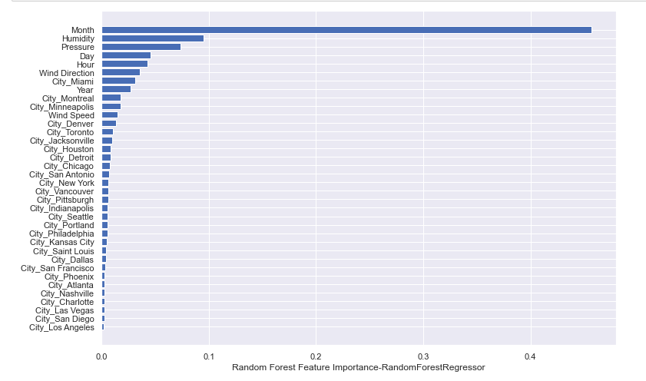
DATA PRE-PROCESSING
Feature Extraction & Engineering Techniques
To discover the important features for the attributes, RandomForestRegressor() was used:

Slide 10
DATA PRE-PROCESSING
Feature Extraction & Engineering Techniques
Some feature engineering techniques used was:
Extracting Day, Month, Year and Hour
Statistical Transformations
Box Cox and Log Transformation

Slide 11

DATA MINING
Random Forest
Decision Tree
AdaBoost
Gradient Boosting
K-Nearest Neighbors

Slide 12
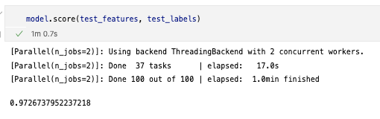
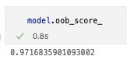
DATA MINING
Random Forest
Took 23.5 minutes
Generated 100 trees, 2 concurrent ThreadingBackends.
Used an evaluation algorithm and bootstrap aggregating/bagging out-of-bag score which converged to a 97% score

Slide 13
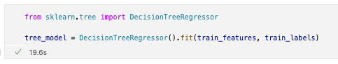
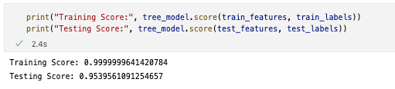
DATA MINING
Decision Tree
23 seconds total, 95% testing score.

Slide 14
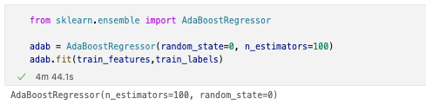
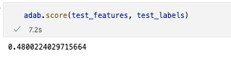
DATA MINING
AdaBoost
Uses boosting method with weak learners
Took 4 minutes to train
Random state of 0 with 100 estimators

Slide 15
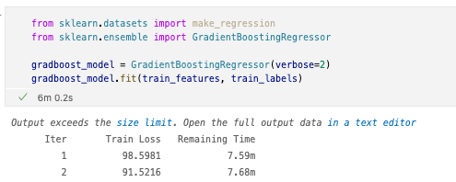
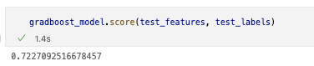
DATA MINING
Gradient Boosting
Minimizes loss of ADABoost models
Took 6 minutes to train

Slide 16
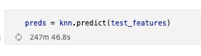
DATA MINING
K Nearest Neighbour
Finds the distance between the inputted sample values and examples throughout the dataset.
Collects the closest examples to the query and assumes an average vote to assign the output.
No training, but did not finish executing due to the large size of the testing data (56000+) and spent an equivalent of 4 hours running before we interrupted it.
It does predict outputs for individual sample, but no way to compare performance.

Slide 17

EVALUATION OF RESULTS
Evaluation of Algorithms
Observations and Model Selection

Slide 18
EVALUATION OF RESULTS
Evaluation of Algorithms
Model | Score | Total Time
Random Forest Regressor | 97% | 25 minutes
Decision Tree Regressor | 95% | 3 seconds
AdaBoost | 48% | 4 minutes
Gradient Boosting Regressor | 72% | 6 minutes
K Nearest Neighbors (KNN) | - | 4 hours +

Slide 19
EVALUATION OF RESULTS
Observation and Model Selection
Focusing on Score vs Computational time, the decision is between Random Forest and Decision Tree.
Random Forest, however proved a higher accuracy.
Although other metrics of model selection exist, such as precision, recall and f1-score, our model values does not fit.
Due to computational time and resources, K-Nearest Neighbour did not seem fit for our need and as such we did not proceed with that.

Slide 20
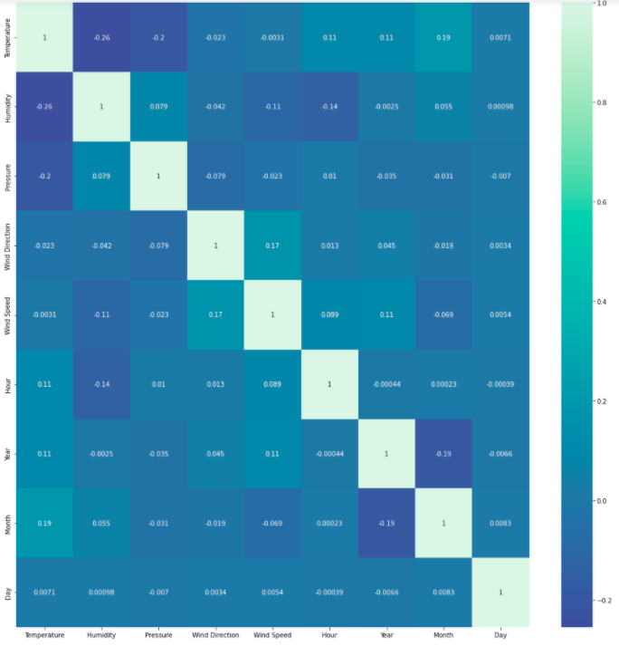
Future Works
Predicting the rest of the weather attributes
Temperature was one amongst the goals we had for this project, however we were bound by computational/capacity and storage constraints.
To predict the other attributes, we thought of a "waterfall" system between our dedicated models.
The order of attribute prediction will depend on the correlation coefficient between the attributes to maximize performance in and avoid the accumulation of errors.
Pressure/Temperature, Humidity/Pressure...

Slide 21


06
WEB APPLICATION
Project Structure
UI and App Use

Slide 22
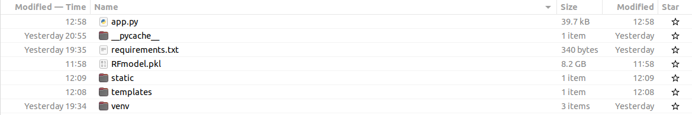
WEB APPLICATION
Project Structure for Server and Web Application

Slide 23
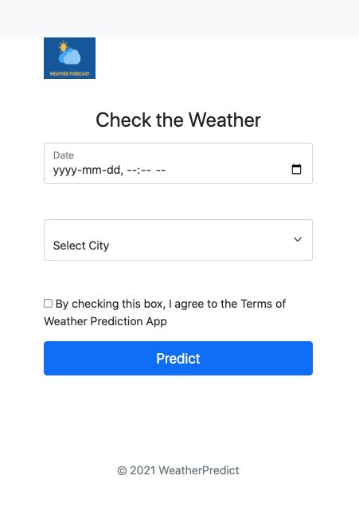
WEB APPLICATION
UI and Use
Start the Server by running app.py
Open browser and type the address http://localhost:5000

Slide 24
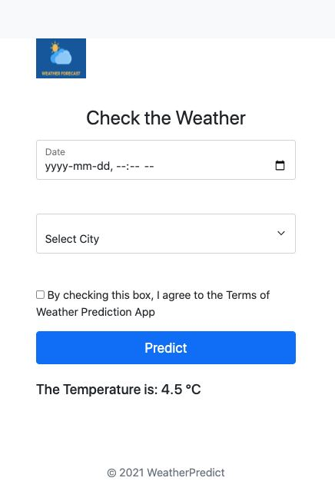
WEB APPLICATION
UI and Use
Enter in the values for date and time.
Choose City from the list of City dropdown
Click Predict

Slide 25
REFERENCES
https://github.com/DM-ML-Weather-Prediction-App/weather-prediction-v3

Slide 26
TEAM
Michael Asante
Aida Himmiche

Slide 27
THANK YOU

